Slide 1

EVEREST PHONES
USER MANUAL

Slide 2
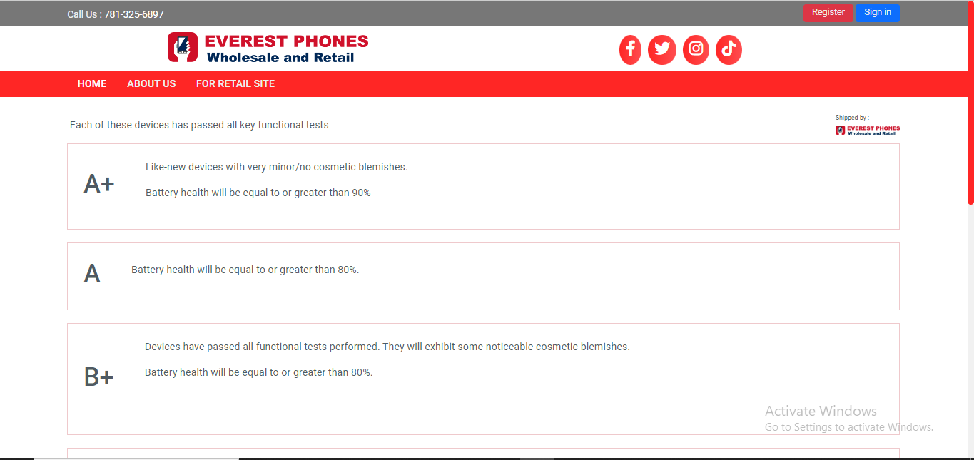
1. Getting Started
To begin shopping, first, create an account by visiting our website at www.everestphones.com and clicking the "Register" button.

Slide 3
1.1 Creating an Account on Everest Phones
To create an account on the Everest Phones Wholesale and Retail site, please follow these steps:
First Name :Enter your first name in the field labeled "First name *".
Last Name :Enter your last name in the field labeled "Last name *".
Business Name :Enter the name of your business in the field labeled "Business name *".
Email :Provide a valid email address in the field labeled "email". This email will be used for account verification and future communication.
Password :Create a strong password in the "Password" field. The password should be at least 8 characters long and include a mix of letters, numbers, and special characters.
Confirm Password :Re-enter the password in the "Confirm password" field to ensure it matches the one you provided above.
Submit the Form :Once all the fields are filled out, click the "Sign Up" button at the bottom of the form to complete your registration.

Slide 4
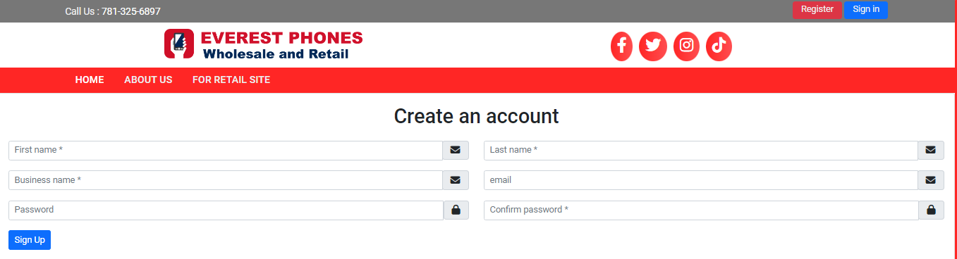
Screenshot of Account Creation

Slide 5
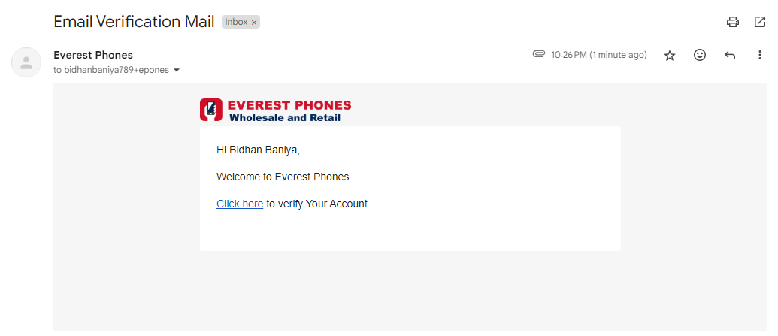
1.2 Email Verification
After submitting the form, check your email for a verification link. Click on this link to verify your email address and wait for account approval.

Slide 6
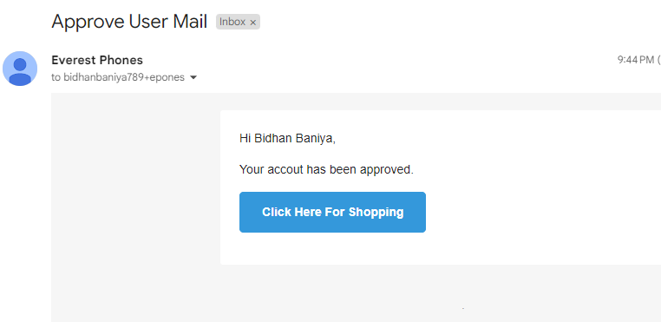
Once your account is approved, you will be notified via the email you used to register.

Slide 7
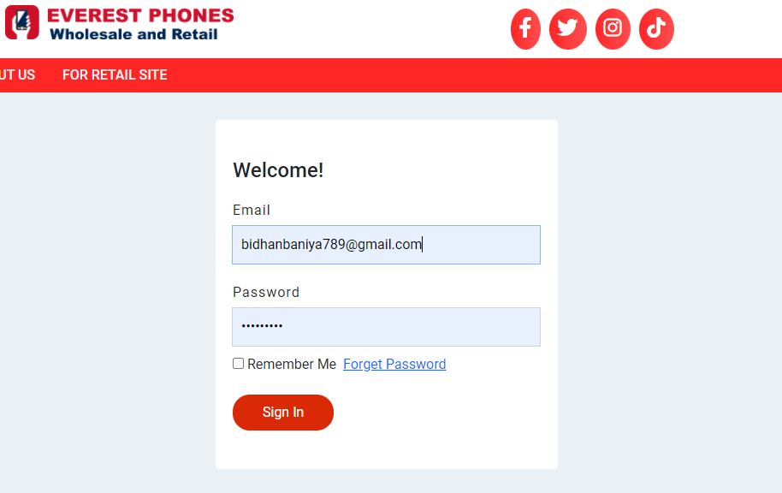
1.3 Sign In
You can sign in by visiting https://everestphones.com/login, entering your email and password credentials, and clicking the 'Sign In' button

Slide 8
1.4 First Time Logging In
Upon your first login, after receiving admin approval, go to https://everestphones.com/login and enter your email and password credentials. Once logged in, you will need to set up your account by providing your business information.
Step 1: Account Setup
When logging into the system for the first time, you will be required to set up your account by providing essential business information. Below are the steps to complete the setup:
1. Business Phone Number
In the "Business phone number" field, enter your business’s primary contact number.
Enter the phone number without the country code.
2. WhatsApp Number (Optional)
If you use WhatsApp for business communication, enter your WhatsApp number in the "WhatsApp number" field.

Slide 9
Step 2: Business Address Setup
Next, you’ll need to fill in your business address details to complete the setup process:
1. Country
Select the country where your business is located from the dropdown list Default is United State.
2. State/Province
Choose your business’s state or province. This field will adjust based on the selected country.
3. City
Enter the city in which your business operates.
4. Street Address
Provide the full street address of your business. This is required for accurate identification and correspondence.
5. Zip/Postal Code
Enter the relevant zip or postal code for your business location.
6. Upload Reseller Certificate
You will need to upload your reseller certificate. To do this, click the Choose File button, select the appropriate file from your device, and upload it.

Slide 10
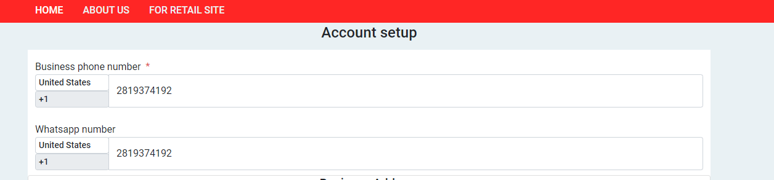
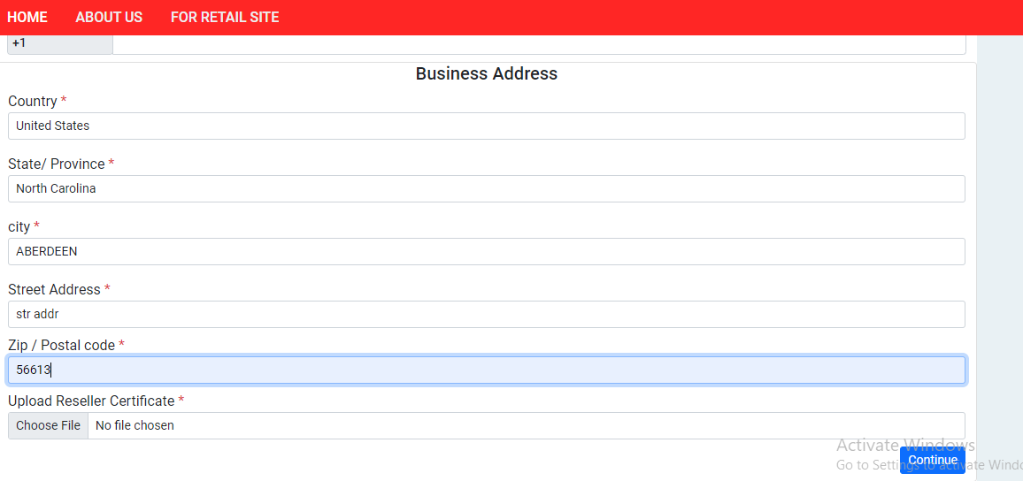
1.5 Screenshot of Account Setup with demo information

Slide 11
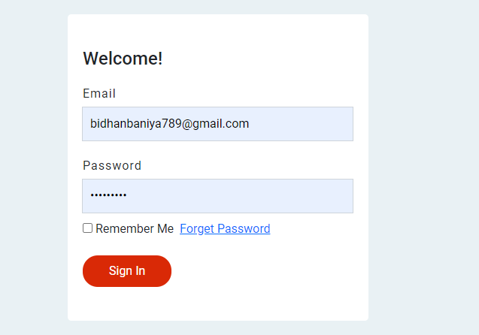
2. Account Access and Core Functions
Unlock a World of Amazing Phones at Your Fingertips
Step 1: Visit our secure login page at https://everestphones.com/login
Step 2: Enter your registered email address and password
Step 3: Click 'Sign In' to access your account and start exploring!

Slide 12
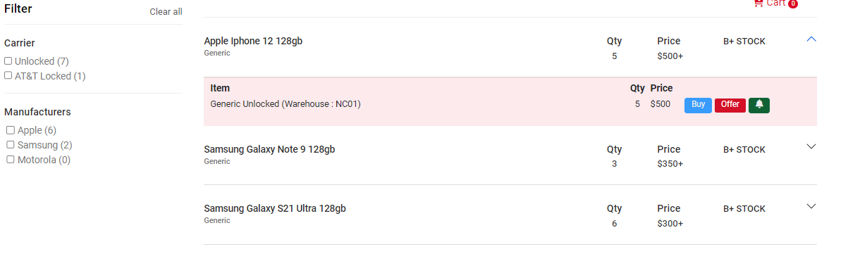
2.1 Stock List
After a successful login, you'll embark on your phone-hunting journey:
Instant Access: You'll be whisked away to our virtual showroom at https://everestphones.com/stock-list
Your Personal Catalog: Behold a curated list of our latest and greatest phones, each with:
• Real-time availability • Competitive pricing • Quality grade scale
Dive Deeper: Curious about a specific model? Simply click on any product to uncover:
• Detailed information • Current warehouse location

Slide 13
2.2 Shipping phones from Everest Phones
When you're ready to make a move on your desired phone, the process couldn't be simpler:
Locate the "Buy Now" button on any products.
Click it to open a handy modal window.
Use the controls to adjust the quantity you'd like to purchase.
Review the detailed product info one more time.
Click "Add to Cart" to safely stow your selection.
Your items are now nestled in your personal shopping cart, just waiting for you to complete the checkout process.
From here, you can continue browsing our full stock list, adjust quantities as needed, or proceed to finalize your order. It's all about giving you the control and flexibility to shop with confidence.

Slide 14
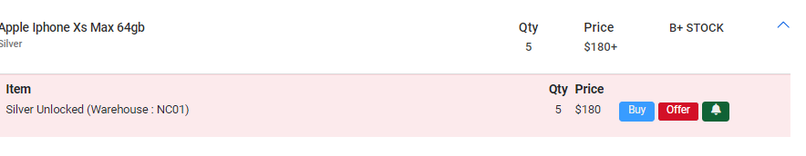
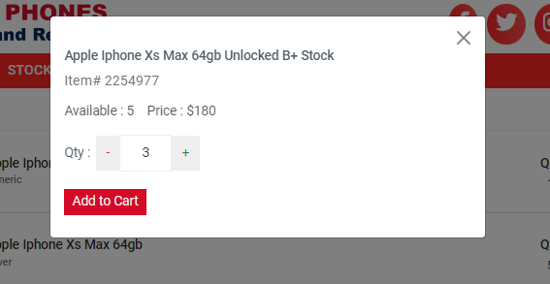
2.3 Screenshot of adding item in cart

Slide 15
2.2 Finalizing Your Order: From Cart to Checkout
Ready to seal the deal on your new phone? Here's how to breeze through the checkout process:
Locate Your Cart: Find the cart icon in the top-right corner of any page. It's your treasure chest of selected items!
Review Your Selections: Click the cart icon to be whisked away to https://everestphones.com/cart
Fine-tune Your Order: • Remove items: Spot a change of heart? Click the 'X' icon next to any item to remove it.
Adjust quantities: Use the quantity controls to get exactly what you need.
Ready, Set, Purchase: When you're satisfied with your selections, hit the "Checkout" button to proceed.
Pro Tip: Double-check your cart before checking out. It's the perfect moment to ensure you're getting everything you want (and nothing you don't)!

Slide 16
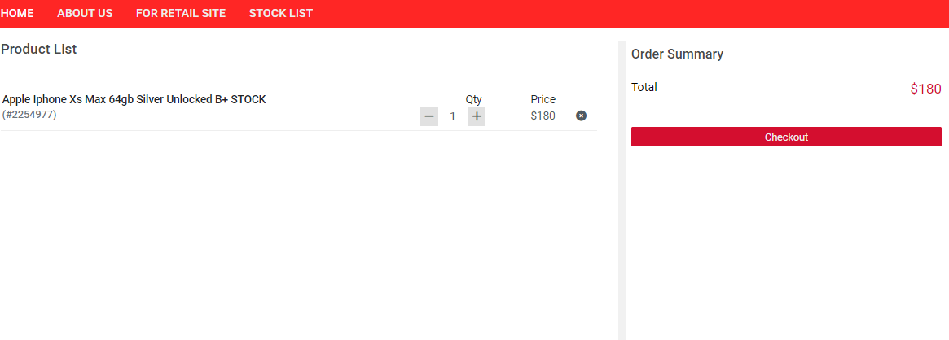
2.2.1 Screenshot of cart page

Slide 17
2.2.1 Navigating the Shipping Section: Completing Your Checkout Process
Once you click the "Checkout" button, you will be redirected to the Shipping Address section at Everest Phones Shipping.
I. Business Address Information:
If your shipping address is the same as your business address, you can easily select the checkbox "Use business address" to auto-fill the details.
Ensure that the business phone number is correct. You can also provide your WhatsApp number if desired.
II. Filling Out the Shipping Form:
Input the necessary fields such as your country which is default United States, state/province, city, street name, and postal code to ensure accurate shipping.
III. Shipping Method:
Select your shipping method based on the options provided, such as Standard (Arrives 3-5 days after shipping).

Slide 18
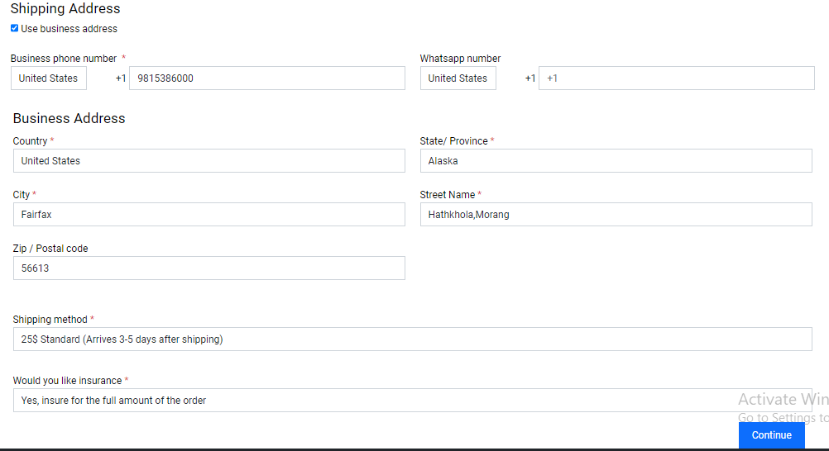
IV. Insurance Option:
To safeguard your purchase, Select the appropriate insurance option before proceeding.
V. Continue to Payment:
After filling out all the necessary fields, click on the "Continue" button to proceed to the order bill review.

Slide 19
2.2.1: Finalizing Your Order: Accepting Terms and Placing Your Purchase
After selecting your shipping method and insurance options, you will be directed to the Product Detail page. Here’s what to expect:
Product Overview:
This section displays a clear summary of the items you are purchasing, including:
i. The product name (e.g., Apple iPhone Xs Max 64gb Silver Unlocked B+),
ii. The quantity (Qty),
iii. The rate per unit and total price of the items.
Shipping and Insurance Costs:
Alongside the product details, you will find the shipping fee and insurance calculated based on your previous selection. For example:
i. Shipping: $25
ii. Insurance: $1.8 (1% of the total price)

Slide 20
Final Total:
The total amount, including the product cost, shipping fee, and insurance, is clearly displayed. In this case, the final total is $206.80.
Add a Note:
Below the product details, there’s a section labeled Note where you can add any special instructions or comments regarding your order. For instance, you can specify delivery preferences or additional details relevant to the purchase.
Commitment to Purchase:
At the bottom of the page, there is a reminder in red text stating: "If you continue this checkout step, you are committing to buy the device(s), failure to make the payment will cancel your order."
This ensures you are aware of your commitment before proceeding to the final step.
Once you have reviewed all the details and, if necessary, added a note, simply click the Continue button.

Slide 21
2.2.2 Reviewing the Terms & Conditions:
After reviewing your order details and clicking "Continue," modal of Terms & Conditions will appear. This is a crucial step to ensure that you understand the policies and legal guidelines associated with your purchase. Here’s what you need to do:
Review the Terms & Conditions:
The Terms & Conditions outlines the website’s rules regarding user behavior, intellectual property protection, and potential legal liabilities. By agreeing to these terms, you enter into a legal contract with the website.
Key points include:
Abusive users: Guidelines on removing abusive content and users.
Intellectual property: Protecting the site’s creative assets from unauthorized use.
Potential litigation: Clarifying that these terms help protect the business from legal disputes.
Check the Agreement Box:
Before proceeding, you must confirm that you agree to the website’s terms by checking the box: “I agree to the terms and conditions as set out by the user agreement.”
Click Continue:
Once you’ve checked the agreement box, click the Continue button to finalize the purchase.
At this stage, your phone order is officially placed, and you will receive an Order Confirmation notification with further details about your purchase via email.

Slide 22
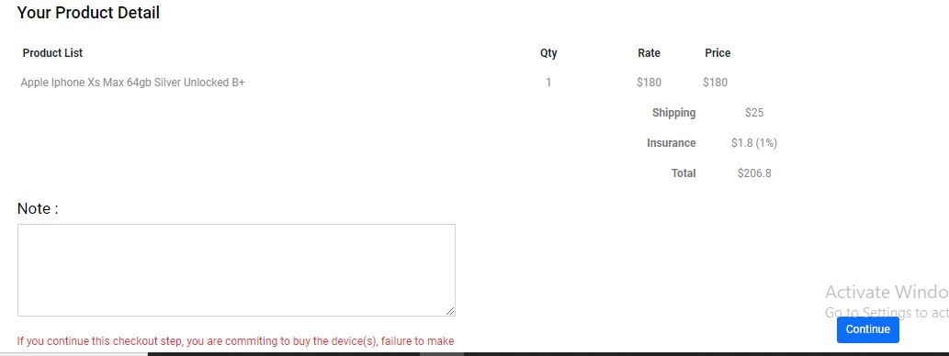
2.2.3 Screenshot of order checkout

Slide 23
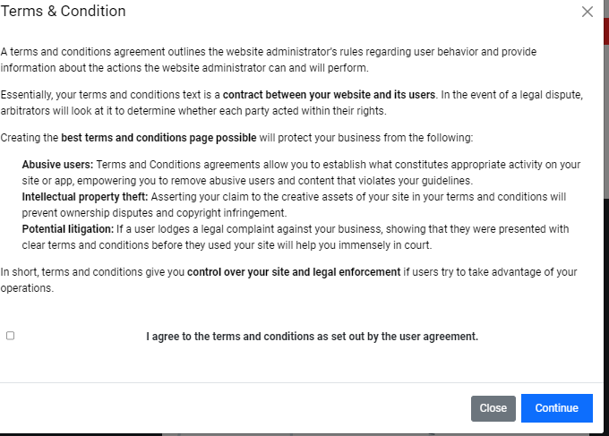
2.2.4 Screenshot of reviewing terms and condition

Slide 24
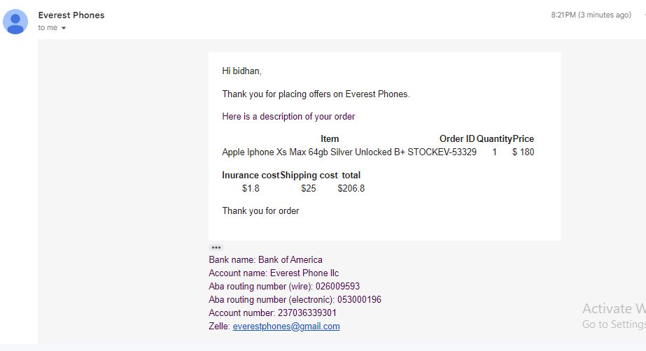
2.2.5 Screenshot of Mail and bank account details

